Slide 1

SEATLLE ACCIDENT REPORTS
ANAYLSIS AND GRAPHS

Slide 2
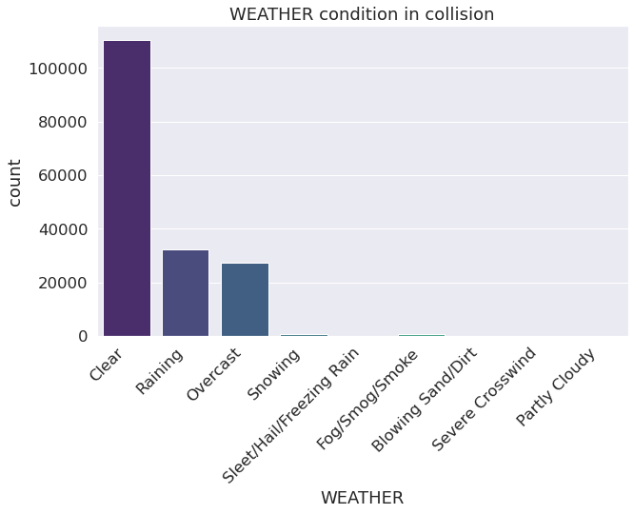
WEATHER AND ACCIDENTS

Slide 3
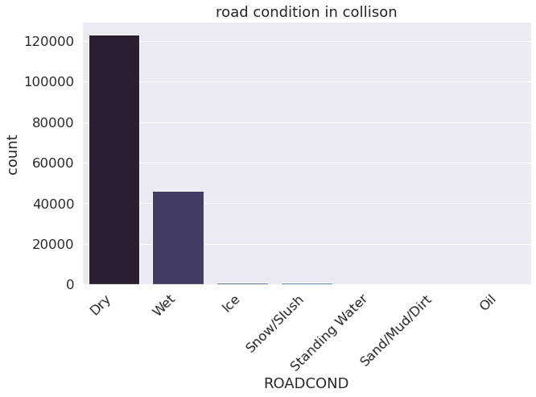
ROAD CONDITION AND ACCIDENTS

Slide 4
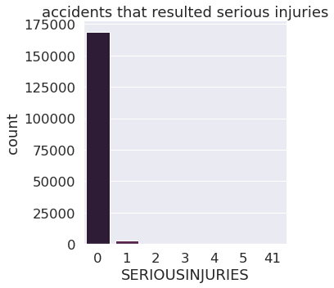
SERIOUS INJURIES

Slide 5
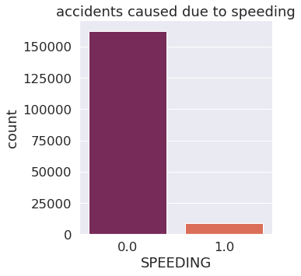
SPEEDING AS CAUSE OF ACCIDENT

Slide 6
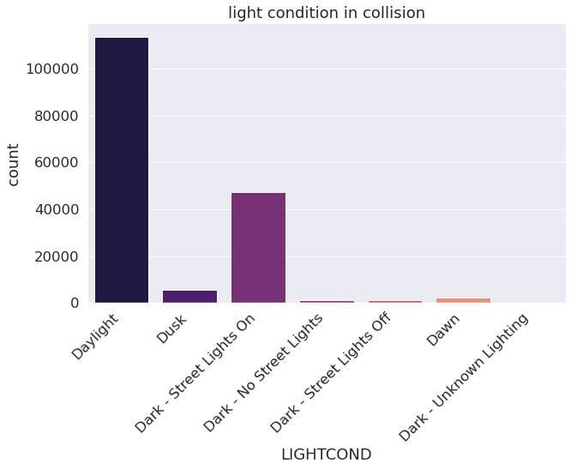
LIGHT CONDITION DURING ACCIDENT
MKALANDAR77@GMAIL.COM
https://github.com/Kalandar77/coursera_capstone.git

Slide 7
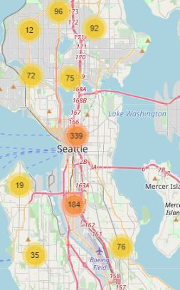
MAP VIEW

Slide 8
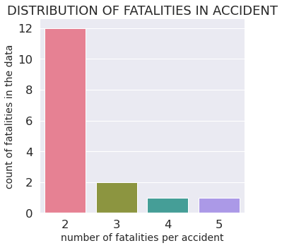
fatalities

Slide 9
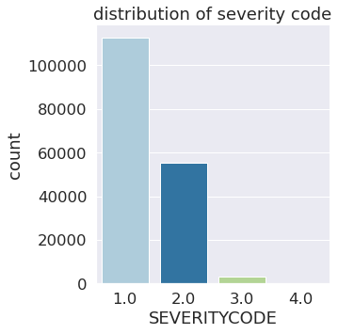
SEVERITY CODE

